Slide 1
Hinrich Schütze and Christina Lioma
Lecture 18: Latent Semantic Indexing

Slide 2
Overview
Latent semantic indexing
Dimensionality reduction
LSI in information retrieval

Slide 3
Outline
Latent semantic indexing
Dimensionality reduction
LSI in information retrieval

Slide 4
Recall: Term-document matrix
 | Anthony and Cleopatra | Julius Caesar | The Tempest | Hamlet | Othello | Macbeth
anthony | 5.25 | 3.18 | 0.0 | 0.0 | 0.0 | 0.35
brutus | 1.21 | 6.10 | 0.0 | 1.0 | 0.0 | 0.0
caesar | 8.59 | 2.54 | 0.0 | 1.51 | 0.25 | 0.0
calpurnia | 0.0 | 1.54 | 0.0 | 0.0 | 0.0 | 0.0
cleopatra | 2.85 | 0.0 | 0.0 | 0.0 | 0.0 | 0.0
mercy | 1.51 | 0.0 | 1.90 | 0.12 | 5.25 | 0.88
worser | 1.37 | 0.0 | 0.11 | 4.15 | 0.25 | 1.95
. . .
This matrix is the basis for computing the similarity between documents and queries. Today: Can we transform this matrix, so that we get a better measure of similarity between documents and queries?
4

Slide 5
Latent semantic indexing: Overview
We will decompose the term-document matrix into a product of matrices.
The particular decomposition we’ll use: singular value decomposition (SVD).
SVD: C = UΣV ^{T} (where C = term-document matrix)
We will then use the SVD to compute a new, improved term-document matrix C′.
We’ll get better similarity values out of C′ (compared to C).
Using SVD for this purpose is called latent semantic indexing or LSI.
5

Slide 6
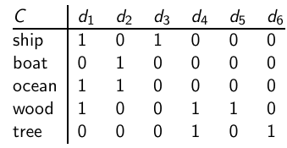
Example of C = UΣV^{T} : The matrix C
This is a standard
term-document matrix. Actually, we use a non-weighted matrix
here to simplify the example.
6

Slide 7
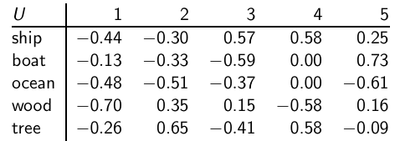
Example of C = UΣV^{T} : The matrix U
One row perterm, one
column per min(M,N) where M is the number of terms and N is the number of documents. This is an orthonormal matrix:
(i) Row vectors have unit length. (ii) Any two distinct row vectors
are orthogonal to each other. Think of the dimensions as “semantic” dimensions that capture distinct topics like politics, sports, economics. Each number u_{ij} in the matrix indicates how strongly related term i is to the topic represented by semantic dimension j .
7

Slide 8
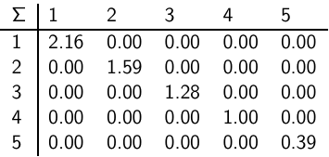
Example of C = UΣV^{T} : The matrix Σ
This is a square, diagonal
matrix of dimensionality min(M,N) × min(M,N). The diagonal
consists of the singular values of C. The magnitude of the singular
value measures the importance of the corresponding semantic
dimension. We’ll make use of this by omitting unimportant
dimensions.
8

Slide 9
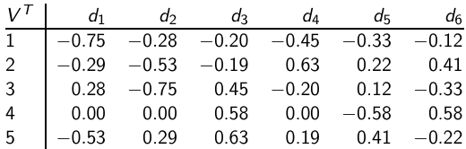
Example of C = UΣV^{T} : The matrix V^{T}
One column per document, one row per min(M,N) where M is the number of terms and N is the number of documents. Again: This is an orthonormal matrix: (i) Column vectors have unit length. (ii) Any two distinct column vectors are orthogonal to each other. These are again the semantic dimensions from the term matrix U that capture distinct topics like politics, sports, economics. Each number v_{ij} in the matrix indicates how strongly related document i is to the topic represented by semantic dimension j .
9

Slide 10
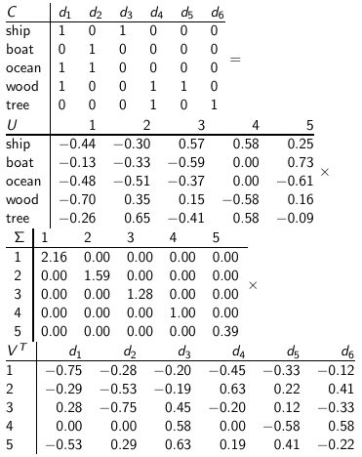
Example of C = UΣV^{T} : All four matrices
10

Slide 11
LSI: Summary
We’ve decomposed the term-document matrix C into a product of three matrices.
The term matrix U – consists of one (row) vector for each term
The document matrix V^{T} – consists of one (column) vector for each document
The singular value matrix Σ – diagonal matrix with singular values, reflecting importance of each dimension
Next: Why are we doing this?
11

Slide 12
Outline
Latent semantic indexing
Dimensionality reduction
LSI in information retrieval

Slide 13
How we use the SVD in LSI
Key property: Each singular value tells us how important its dimension is.
By setting less important dimensions to zero, we keep the important information, but get rid of the “details”.
These details may
be noise – in that case, reduced LSI is a better representation because it is less noisy
make things dissimilar that should be similar – again reduced LSI is a better representation because it represents similarity better.
Analogy for “fewer details is better”
Image of a bright red flower
Image of a black and white flower
Omitting color makes is easier to see similarity
13

Slide 14
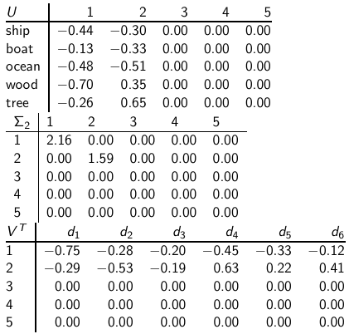
Reducing the dimensionality to 2
Actually, we
only zero out
singular values
in Σ. This has
the effect of
setting the
corresponding
dimensions in
U and V ^{T} to
zero when
computing the
product
C = UΣV ^{T} .
14

Slide 15
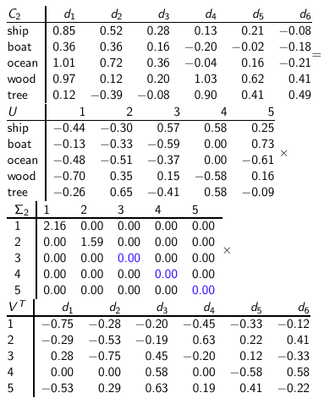
Reducing the dimensionality to 2
15

Slide 16
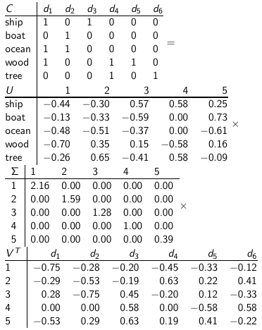
Recall unreduced decomposition C=UΣV^{T}
16

Slide 17
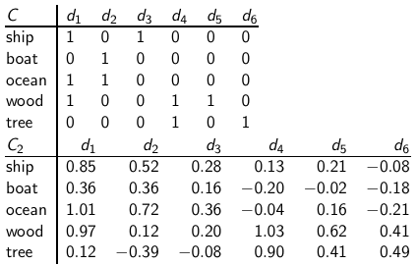
Original matrix C vs. reduced C₂ = UΣ₂V^{T}
We can view
C₂ as a two-dimensional
representation
of the matrix.
We have
performed a
dimensionality
reduction to
two
dimensions.
17

Slide 18
Why the reduced matrix is “better”
Similarity of d2 and d3 in the original space: 0.
Similarity of d2 und d3 in the reduced space:
0.52 * 0.28 + 0.36 * 0.16 + 0.72 * 0.36 + 0.12 * 0.20 + - 0.39 * - 0.08 ≈ 0.52
18

Slide 19
Why the reduced matrix is “better”
“boat” and “ship” are semantically similar. The “reduced” similarity measure reflects this.
What property of the SVD reduction is responsible for improved similarity?
19

Slide 20
Why the reduced matrix is “better”
20

Slide 21
Why the reduced matrix is “better”
21

Slide 22
Outline
Latent semantic indexing
Dimensionality reduction
LSI in information retrieval

Slide 23
Why we use LSI in information retrieval
LSI takes documents that are semantically similar (= talk about the same topics), . . .
. . . but are not similar in the vector space (because they use different words) . . .
. . . and re-represents them in a reduced vector space . . .
. . . in which they have higher similarity.
Thus, LSI addresses the problems of synonymy and semantic relatedness.
Standard vector space: Synonyms contribute nothing to document similarity.
Desired effect of LSI: Synonyms contribute strongly to document similarity.
23

Slide 24
How LSI addresses synonymy and semantic relatedness
The dimensionality reduction forces us to omit a lot of “detail”.
We have to map differents words (= different dimensions of the full space) to the same dimension in the reduced space.
The “cost” of mapping synonyms to the same dimension is much less than the cost of collapsing unrelated words.
SVD selects the “least costly” mapping (see below).
Thus, it will map synonyms to the same dimension.
But it will avoid doing that for unrelated words.
24

Slide 25
LSI: Comparison to other approaches
Recap: Relevance feedback and query expansion are used to increase recall in information retrieval – if query and documents have (in the extreme case) no terms in common.
LSI increases recall and hurts precision.
Thus, it addresses the same problems as (pseudo) relevance feedback and query expansion . . .
. . . and it has the same problems.
25

Slide 26


Implementation
Compute SVD of term-document matrix
Reduce the space and compute reduced document representations
Map the query into the reduced space
This follows from:
Compute similarity of q₂ with all reduced documents in V₂.
Output ranked list of documents as usual
Exercise: What is the fundamental problem with this approach?
26

Slide 27

Optimality
SVD is optimal in the following sense.
Keeping the k largest singular values and setting all others to zero gives you the optimal approximation of the original matrix C. Eckart-Young theorem
Optimal: no other matrix of the same rank (= with the same underlying dimensionality) approximates C better.
Measure of approximation is Frobenius norm:
So LSI uses the “best possible” matrix.
Caveat: There is only a tenuous relationship between the Frobenius norm and cosine similarity between documents.
27

Slide 28
Resources
Chapter 18 of IIR
Resources at http://ifnlp.org/ir
Original paper on latent semantic indexing by Deerwester et al.
Paper on probabilistic LSI by Thomas Hofmann
Word space: LSI for words
28

